Slide 1
Sample
Peer Support Training

Slide 2
Welcome and Overview
Hospital Leadership and Sponsoring Leader

Slide 3
Introductions
Trainer 1 – Name
Title
Department
Trainer 2 – Name
Title
Department

Slide 4

Small Group Exercise

Slide 5
Internal Supports

Slide 6
Examples
EAP – Employee Assistance Program
Chaplaincy
Social Work
Psychiatry

Slide 7
Brief History of Clinician Support and “Second Victim”

Slide 8

What Does It Look Like?

Slide 9
From Sue Scott’s Work

Slide 10
“I remember feeling horribly sad that I couldn’t do more for this child. This hit me harder than most of them. For some reason I really related with this family—I guess one reason is that the child was the age of my oldest daughter and I guess that I felt that this could have been my family. They were a nice family and didn’t deserve to have this outcome. I cried a lot over this case and I guess I still cry when I think about her.”
“I thought every single day for months I’d walk in and think everyone knows what happened because that’s what happens in a unit where everyone works closely. I thought, ‘‘Do they think of me everyday as this loser who doesn’t know what is going on?’’ and ‘‘These people are never going to trust me again’’..
“I started to doubt myself. This shouldn’t have happened. It was all hindsight but I kind of kept thinking over and over again. I lost my confidence for some time.”

Slide 11
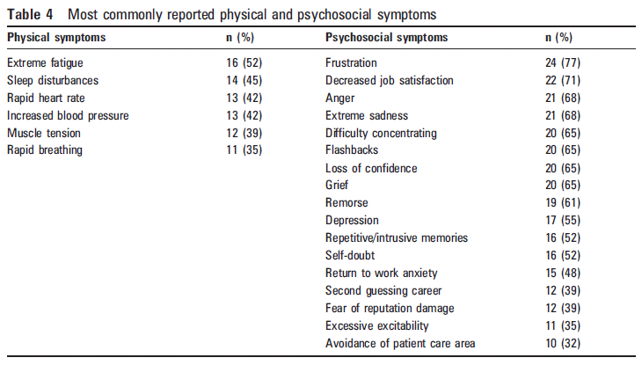

Slide 12
Second Victim Recovery Trajectory
Stages 1-3 Impact Realization |  |  | Stage 4 Enduring the Inquisition | Stage 5 Obtaining Emotional First Aid | Stage 6 Moving On
Chaos & Accident Response | Intrusive Reflections | Restoring Personal Integrity |  |  | Drop Out | Survive | Thrive
(Individual may experience one
or more of these stages simultaneously)

Slide 13
Six Stages
Chaos
  “OMG What did I do?”
  Caring for patient
Intrusive reflections
  Re-living
  “What did I miss?”
Restoring Integrity
  What will people think
  Fear for job
Enduring the Inquisition
  M+M
  Medico-legal
Emotional first aid
  Colleagues/family
Moving on
  Thriving
  Surviving
  Dropping out

Slide 14
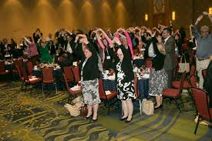

Break

Slide 16
Peer Support Basics - Skill Building

Slide 17
Peer Support Team: Hallmarks
Credibility of peers
Immediate availability
Voluntary access
Confidential
Emotional “first aid” (not therapy!)
Facilitated access to next level of support

Slide 18
Peer Supporter Role Description
What a Peer Supporter Does | What a Peer Supporter Does NOT Do
Normalizes feelings of peer | Participate in Quality Assurance, RCAs
Validates competence of peer | Offer disclosure coaching
Assesses peer’s need for professional resources | Deal with job performance issues
Directs peer to other resources as appropriate | Handle substance abuse coaching or violence prevention
Follows up with peer in the short term and long term to “check-in” | Offer malpractice suit support (there are other resources for this)
Notes:
Pat

Slide 19
Basic Peer Communication Techniques
Peers should be mainly listening
Use “I” statements
Maintain eye contact
*Relate personal experiences to their situation
Pay attention to your non-verbal cues. Sit, Sit, Sit
Don’t assume your experience is the same
Don’t judge/don’t fix
Notes:
Pat

Slide 20
The Three Tiered Model of Support

Slide 21
Clinician Support Interventions
First Tier – ‘Local’ support
  Support Basics
  Working with Staff in Crisis

Slide 22

Five Key Actions –
Department Leaders
Connect with clinical staff involved
Reaffirm confidence in staff
Consider calling in flex staff
Notify staff of next steps – keep them informed
Check on them regularly

Slide 23
Clinician Support Interventions
Third Tier Interventional Strategy
Referral to Chaplains, Employee Assistance Program (EAP), Social Service, Personal Counselor and/or psychiatry

Slide 24
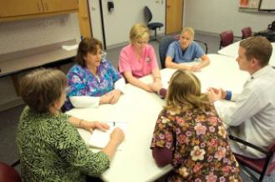

Clinician Support Interventions
Second Tier Interventional Strategy
    One on one peer support
    Team De-Briefings
      About support!!!!

Slide 25
Structure of a Peer Support Conversation
Introduction
Exploration
Coping Strategies/Normalizing
Other Resources and Follow Up

Slide 26
1. The Reach Out - Introduction
Introduce yourself as the Support Team member
Available to talk about event
Voluntary
Confidential
Not an operational critique of event
Notes:
Barbara
Do need to mention duty to report and peer support does not grant peer review privilege.

Slide 27
Ways to reach out
In person (when the peer is alone or on an appropriate break from work)
On the phone
By email (when not urgent)
Notes:
Barbara

Slide 28

Scenario #1

Slide 29
2. Exploration
Allow time for the expression of emotions…
What are their thoughts…
What are their reactions…
What are their symptoms…
  How do you feel about what happened?
  What part are you having problems with right now?
  Are you having any unusual or disruptive thoughts?

Slide 30
Guidelines for the General Discussion
Listen and allow for silence
Express appreciation for sharing
Restate, paraphrase, reflect emotion, normalizing emotions
Summarize
  It sounds like you are saying…
  I can see you are upset
Notes:
Barbara

Slide 31
Scenario #2

Slide 32
Lunch

Slide 33

Resilience Skills

Slide 34
3. Coping: drawing on the peer’s past experience
Ask them…
What has worked for you in the past when you are stressed? Can you do more of that?
Who do you have for supports?
What’s your plan when you leave here?
Are you going to be okay?
Notes:
Barbara

Slide 35
Some “don’ts”
“That’s not so bad.”
  Don’t downplay their feelings.
“Wow. That sounds like a bad mistake. You must feel awful.”
  Don’t undermine their competency/confidence
“What happened to me was much worse!” It’s NOT about you!
  Don’t take over the conversation with your own experience, but do briefly share your own experience to reduce the peers feelings of isolation/shame.
Notes:
Pat/Barbara

Slide 36
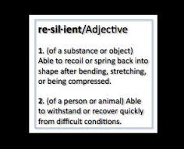
Facilitating resilience
Tell the peer to…
Determine what you can control
  Take control of what you can
  Let go of what you cannot
Avoid obsessive feedback loop
  Keep your head where your hands/
  feet are
Develop a support system
  Spend time with positive people
Manage expectations
Take Care of You
  Eat Right, Get Sleep
  Allow yourself to have fun
  (Re-iterate how difficult some of these simple things are during times of stress)
Notes:
In relation to the stressors you are dealing with today.
To help cope with the change, determine what you can control…
Evaluate your current support systems and consider which support system you wish to strengthen and those you wish to eliminate. Reach out to others e.g church, coworkers, family, friends
Manage expectations-shoulda all over you. To help with perfectionism, what is really expected of you.

Slide 37
Grounding
Helps separate from emotional pain
Focus outward on external world
Rate mood before and after grounding to test if it worked (0-10) 10= extreme pain.
Keep eyes open, scan room, keep lights on, to help stay in touch with the present moment.
No talking about negative feelings or journal writing because you want to distract away from intense feeling at this point.
Stay neutral…do not judge surroundings for example if describing the walls you would think the walls are yellow, not the walls are ugly.
Focus on the present moment not the future or the past
Grounding is not a relaxation training…it is more active strategy.

Slide 38
Some tools:
Calm
Virtual Hope Box
Ten Percent
Mood Path

Slide 39
Scenario #3

Slide 40
4. Resources and Follow Up
Is more support needed?
  Provide
    Pamphlets or fliers (if available)
    Articles that might be helpful – Sue Scott’s – Natural History of Second Victim Support
    Annotated Bibliography
  Ask if you can touch base as needed (1 day- 2 wks.)
  Your contact information
Referral to additional resources
  Patient Safety
  Risk Management – if the supportee needs more information about the process (if applicable)
  Department Leaders
  External Resources
    A therapist who has a practice for clinicians
    EAP
Additional assistance (Caution)
  Contact team leader (especially if concerned about their safety and the safety of others)

Slide 41

Words of Caution for Peer Supporters
Know your limits
Know your own issues
Beware your prejudices/judgments
Supporting the peer supporter is essential
Notes:
We spent today together….now you have developed new relationships …alliances

Slide 42
Scenario #4

Slide 43


Slide 44
Peer Supporter Toolbox
Quick Reference Guide of Peer Support Steps
Listening Skills
Do’s and Don'ts of Good Listening
Pocket Guide: Caring for Yourself in the Face of Difficult Work
Common Reactions to Trauma
List of Articles we recommend

Slide 45
Review of Special Considerations and Overcoming Obstacles for the Clinician Support Team

Slide 46
The Joint Commission
LD .04.04.05 EP9
The leaders make support systems available for staff who have been involved in an adverse or sentinel event.

Slide 47
Challenges to Providing Support
Stigma to reaching out for help
High acuity areas have little time to integrate what has happened
Intense fear of the unknown
Fear a compromise of collegial relationships because of event
Fear of future legal woes - HIPAA, confidentiality Implications

Slide 48

Medical Legal Implications
Partner with Risk Manager and Hospital’s General Counsel
Agreement of services to offer
Gain support
Keep informed
Main issues = Confidentiality and Discoverability

Slide 49
Final Thoughts
You probably don’t feel like you are ready to be a supporter. You don’t have to be perfect. You are better than they have now
Like everything, you will get better with practice. Be brave and be helpful
We are at the end of a phone to help

Slide 50
Wrap up and
Evaluations

